Slide 1

A complete example of how to link data

Slide 2
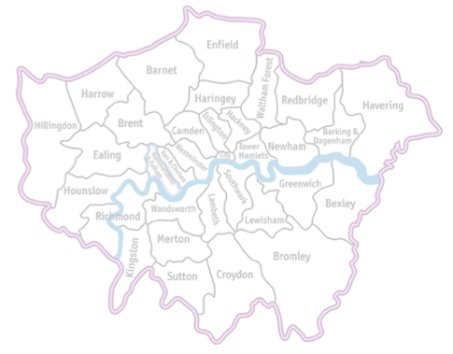
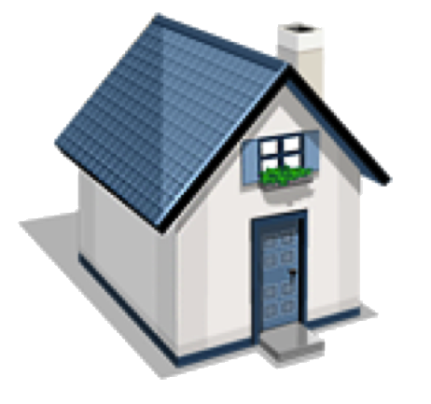
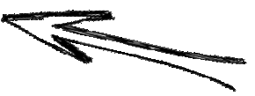



Real estate agency
Here is your dream home!
Client

Slide 3
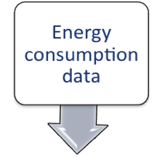
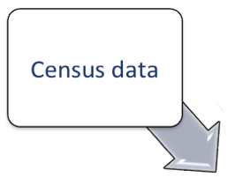
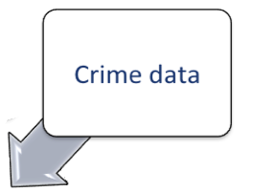
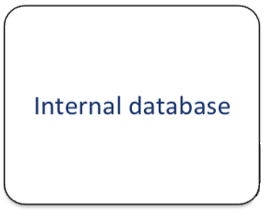
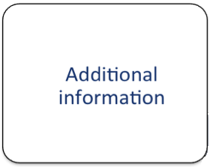
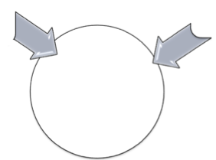
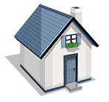
☺
$$$

Slide 4
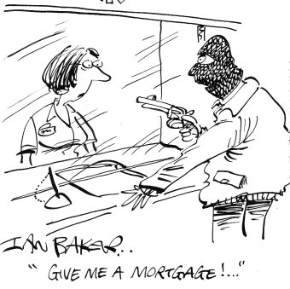

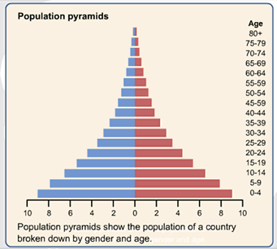

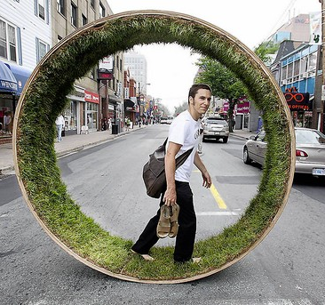




Mature
Green spaces
Robberies
Young
Crimes
Structure of population
Retired
Immigrants
Nationalities
Energy consumption

Slide 5
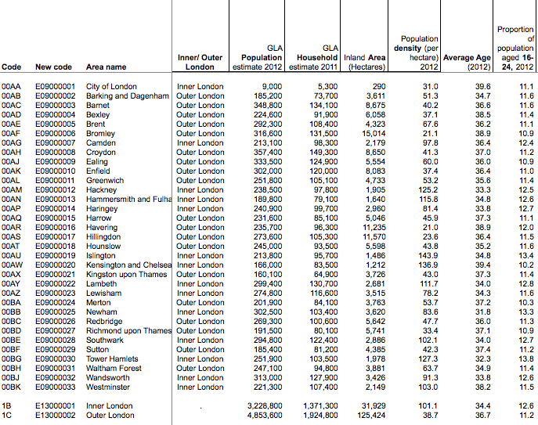
London borough profiles

Slide 6
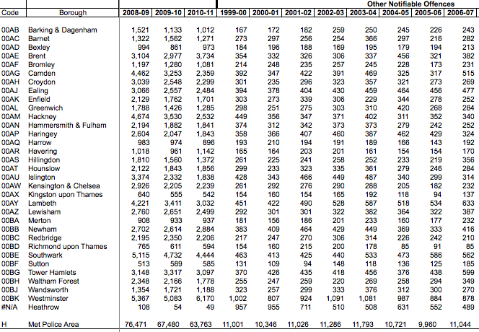
Crime rates in boroughs

Slide 7
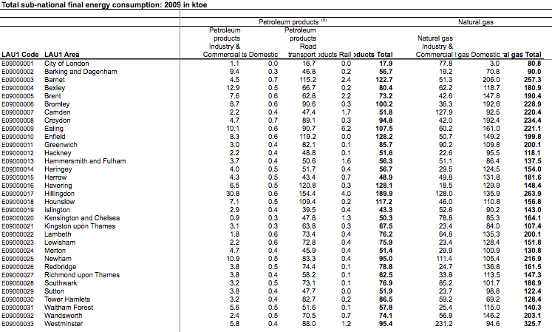
Total energy consumption

Slide 8
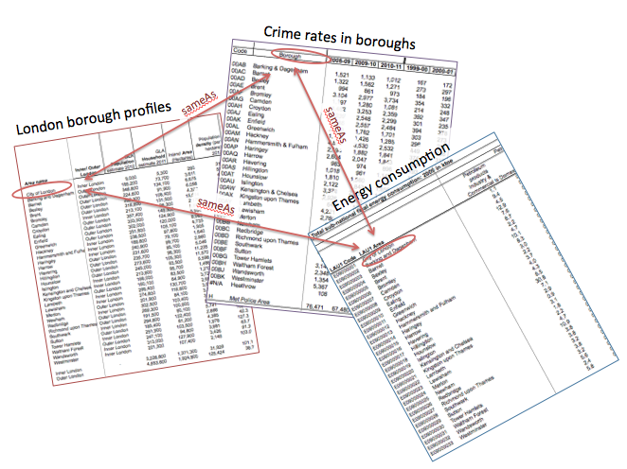

Slide 9
How to connect data?
Google Refne
Energy consumption
Unifying and cleaning
Converting to RDF
Linking to other data sources
Publishing on the Web
WWW
Crime data
Census data
Storing

Slide 10

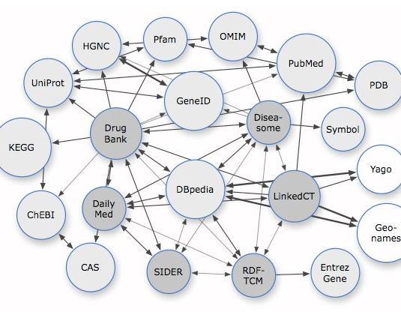
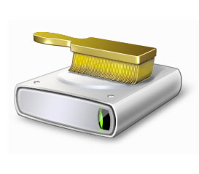

What for?
Clean up raw data
Identify duplicates
Discover patterns
Link data to registry
e.g. Freebase
Make data consistent
Spot inconsistencies

Slide 11
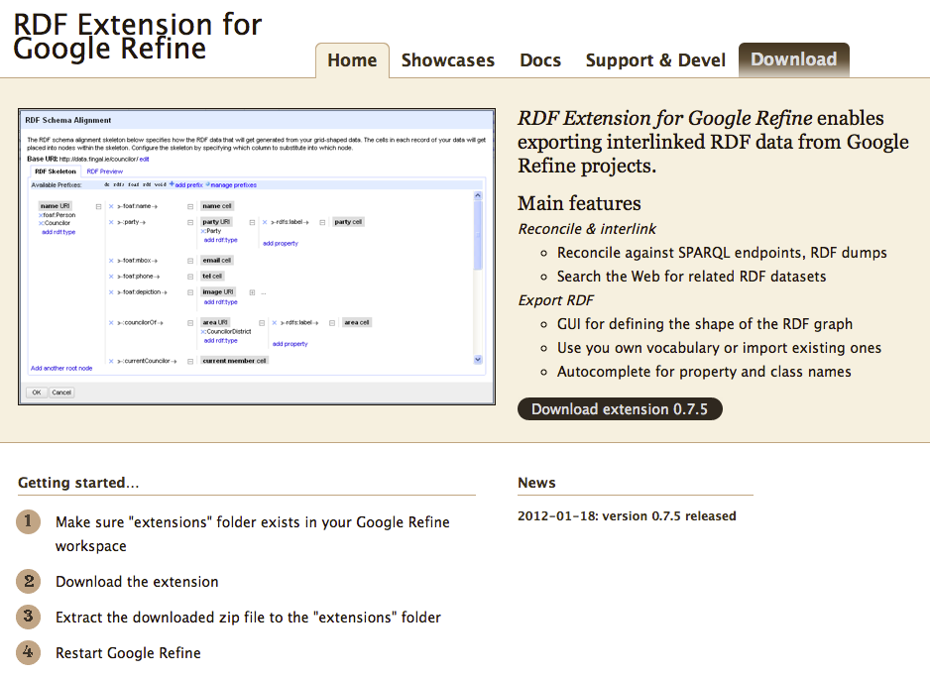

Slide 12
Formats supported
TSV, CSV or values separated by a custom separator you specify
Excel
Google spreadsheets
XML, RDF as XML
RDF N3 files
JSON

Slide 13
Google Refine
Energy consumption
Unifying and cleaning
Converting to RDF
Linking to other data sources
Publishing on the Web
WWW
Crime data
Borough profiles
Storing
Reconciliation
Building a skeleton

Slide 14
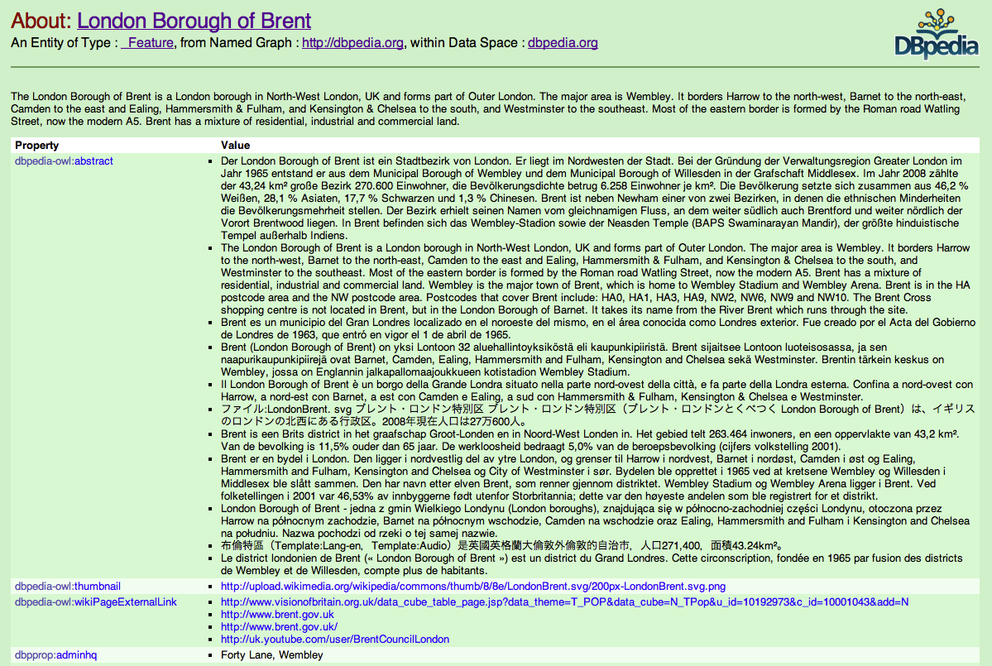

Slide 15
Google Refine
Energy consumption
Unifying and cleaning
Converting to RDF
Linking to other data sources
Publishing on the Web
WWW
Crime data
Census data
Storing
Reconciliation
Building a skeleton

Slide 16
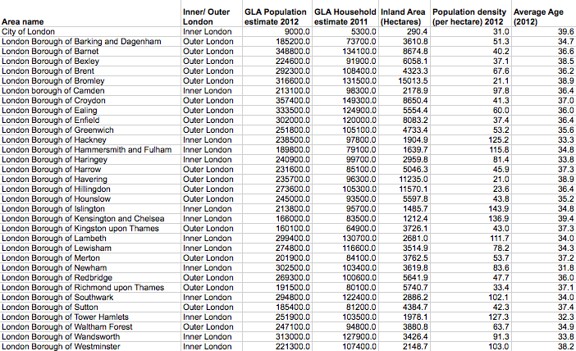

London boroughs
has label
Dataset
has structure
components
Specified by
Defined by
properties
Defined by columns in the table
represent type
have label
Header of the column
e.g. measure

Slide 17
London boroughs
has label
Dataset
has structure
components
Specified by
Defined by
properties
Defined by columns in the table
represent type
have label
Header of the column
e.g. measure

Slide 18
London boroughs

Slide 19
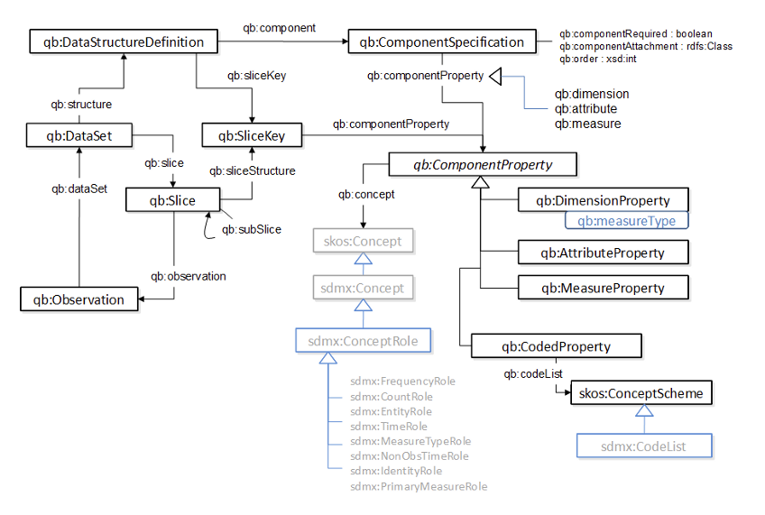
London boroughs
has label
Dataset
has structure
Defined by
components
Specified by
properties
Defined by columns in the table
Cube vocabulary
represent type
have label
Header of the column
e.g. measure

Slide 20
London boroughs
rdfs:label
qb:dataSet
qb:structure
qb:component
qb:ComponentSpecification
qb:DataStructureDefinition
e.g. qb:measure
qb:ComponentProperty
e.g. qb: MeasureProperty
rdfs:label
“Area name”
e.g. measure

Slide 21
Google Refine
Energy consumption
Unifying and cleaning
Converting to RDF
Linking to other data sources
Publishing on the Web
WWW
Crime data
Census data
Storing
Reconciliation
Defining structure
Building a skeleton
Filling with values

Slide 22
Pubby
Silk
Google Refine
Energy consumption
Unifying and cleaning
Converting to RDF
Linking to other data sources
Publishing on the Web
WWW
Crime data
Census data
Fuseki
Storing

Slide 23
London boroughs
rdfs:label
qb:dataSet
qb:structure
qb:DataStructureDefinition
qb:component
qb:ComponentSpecification
qb:ComponentSpecification
…
e.g. qb:measure
qb:ComponentSpecification
…
qb:ComponentProperty
qb:ComponentSpecification
…
qb:ComponentSpecification
…
rdfs:label
Energy consumption
e.g. qb: MeasureProperty
rdfs:label
“Area name”
qb:dataSet
qb:structure
qb:DataStructureDefinition
qb:component
qb:ComponentSpecification
…
e.g. qb:measure
e.g. measure
qb:ComponentSpecification
qb:ComponentSpecification
…
qb:ComponentProperty
qb:ComponentSpecification
…
Area name URI
qb:ComponentSpecification
…
rdfs:label
Crime rates in boroughs
e.g. qb: MeasureProperty
rdfs:label
“LAU1 Area”
qb:dataSet
qb:structure
qb:DataStructureDefinition
qb:component
qb:ComponentSpecification
…
e.g. qb:measure
e.g. measure
sameAs
qb:ComponentSpecification
qb:ComponentSpecification
…
qb:ComponentProperty
…
Area name URI
qb:ComponentSpecification
…
qb:ComponentSpecification
rdfs:label
e.g. qb: MeasureProperty
“Borough”
sameAs
e.g. measure
sameAs
Area name URI

Slide 24
London boroughs
rdfs:label
qb:dataSet
qb:structure
qb:DataStructureDefinition
qb:component
qb:ComponentSpecification
qb:ComponentSpecification
…
e.g. qb:measure
qb:ComponentSpecification
…
qb:ComponentProperty
qb:ComponentSpecification
…
qb:ComponentSpecification
…
rdfs:label
qb:dataSet
e.g. qb: MeasureProperty
qb:Observation
Crime rates in boroughs
“Area name”
rdfs:label
qb:dataSet
qb:structure
qb:DataStructureDefinition
qb:component
qb:ComponentSpecification
e.g. measure
qb:ComponentSpecification
…
e.g. qb:measure
http://example.org/def/statistical-dimension/area-name
…
qb:ComponentProperty
Area name URI
qb:ComponentSpecification
…
qb:ComponentSpecification
…
qb:ComponentSpecification
rdfs:label
qb:dataSet
e.g. qb: MeasureProperty
qb:Observation
“Borough”
e.g. measure
sameAs
http://example.org/def/statistical-dimension/area-name
Area name URI

Slide 25
Thank you for your attention
☺

